Slide 1


AR–SHOP
Team: LA VIDA LOCA
Members:
Avinandan Roy(221-15-4899)
Arafat Rahman Shakib(221-15-5422)
MST.Jannati Nahid Jui(221-15-5523)
Sanjida Akter Bably(221-15-5615)
MST.Kanij Fatima(221-15-5702)

Slide 2
OVERVEIW
The primary objectives of the e-commerce website are as follows:
Provide an intuitive and responsive user interface for seamless browsing on both desktop and mobile devices.
Enable users to create accounts, add products to their cart, and complete purchases securely.
Integrate a secure payment gateway to facilitate smooth transactions.
Implement inventory management to track product stock in real-time.

Slide 3
Introduction
The goal of this project is to design and develop a modern, user-friendly, and scalable e-commerce platform that allows users to browse and purchase products online. This proposal outlines the key objectives, scope, timeline, and technical requirements for the successful completion of the project.

Slide 4
OBJECTIVES
The primary objectives of the e-commerce website are as follows:
Provide an intuitive and responsive user interface for seamless browsing on both desktop and mobile devices.
Enable users to create accounts, add products to their cart, and complete purchases securely.
Integrate a secure payment gateway to facilitate smooth transactions.
Implement inventory management to track product stock in real-time.
Provide an easy-to-use admin dashboard for managing products, orders, customers, and analytics. Ensure security measures such as user authentication.
Improve site visibility.

Slide 5
Why did we choose this project?
Growing demand: More people shop online.
Global reach: Sell to anyone, anywhere.
Low cost: cheaper than a physical store.
Convenient: Customers love 24/7 shopping.
Easy to grow: Add more products, reach more people.

Slide 6
Planning the user experience: 1. Sales Journey 2. Prepare main UX components
Design Stage
Frontend: react.js framework, bootstrap.css framework, redux, axios.
Backend: django.py framework.
Database: postgreSql.

Slide 7
DEVELPOMENT PHASE
Considering the project scope as it is set at the moment and if no major changes are made to it, this is our development phase for your project.
Frontend development
Homepage Design
Product Listings
Product Details Page
Shopping Cart
User Registration and Login
Responsive Design

Slide 8
Backend development
Admin Dashboard
Product Management
Order Management
Shopping Cart
Payment Gateway Integration
Security

Slide 9





Data Flow Diagram
Advantages
Clarity in Process Understanding
Early Detection of Issues
Simplifies Maintenance
Supports Modularity
Disadvantages
Lack of Detail
Can Become Complex
Requires Completeness
https://tinyurl.com/39bjhrbk

Slide 10

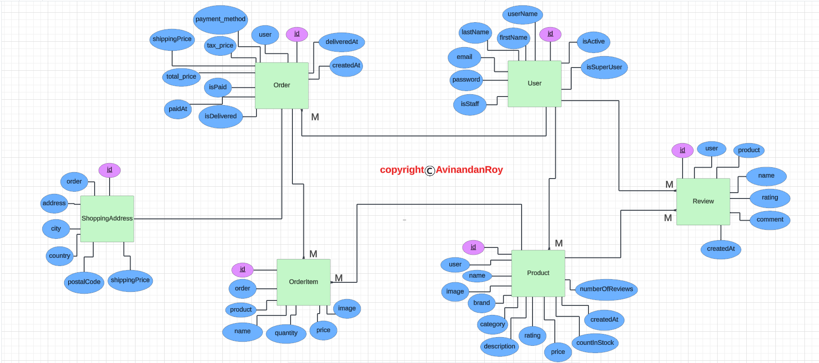

Slide 11

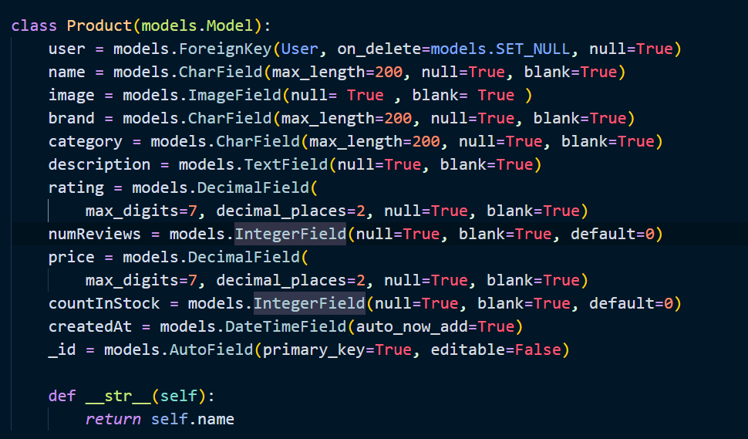

Slide 12
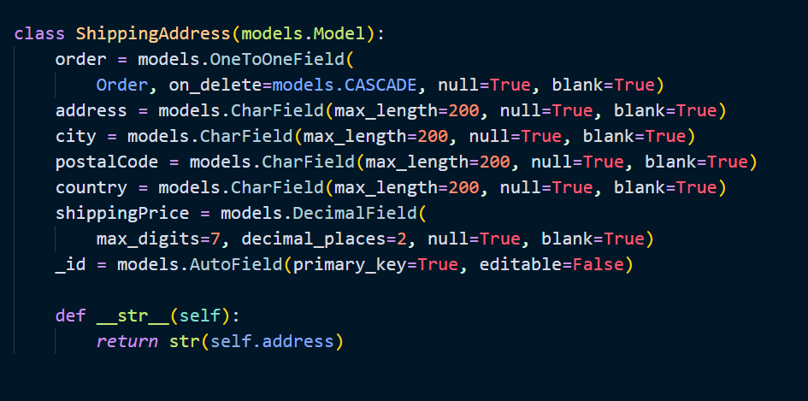


Slide 13
HOW MY PROJECT IS BETTER?
Superior User Experience (UX) : Personalized Shopping Experience, Advanced Search Functionality
Better Security and Privacy: Advanced Security Features, Two-factor Authentication (2FA).
Unique Selling Features: Augmented Reality (AR) Integration, AI-powered Virtual Assistant.
Efficient Checkout Process: One-click Checkout, Multiple Payment Options.

Slide 14
CONCLUSION
The project's main goals of developing a reliable and easy-to-use online purchasing platform were effectively met by the e-commerce website. While providing a fun and effective shopping experience, the platform enables customers to easily browse, choose, and buy products in a secure setting.The initiative has created a solid basis for a cutting-edge, competitive, and expandable e-commerce platform.

Slide 15
THANK YOU

